Slide 1

Big Mountain Resort Pricing
Data-driven Analysis and Price Recommendation

Slide 2
Big Mountain Resort currently establishes prices for its ski passes by setting a price above the simple market average, but a more data-driven approach could lead to reduced costs and increased ticket prices.

Slide 3
Price Prediction Goal
Analyze data from 330 competing ski resorts
Determine which features most closely correlate with price
Predict a price that supports current and future capital expenditure while remaining competitive within the market

Slide 4
Recommendations
Remove 5 runs with lowest traffic
Increase vertical drop by 150 ft, adding 1 run and 1 chair lift
Increase ticket prices from $81 to $90

Slide 5
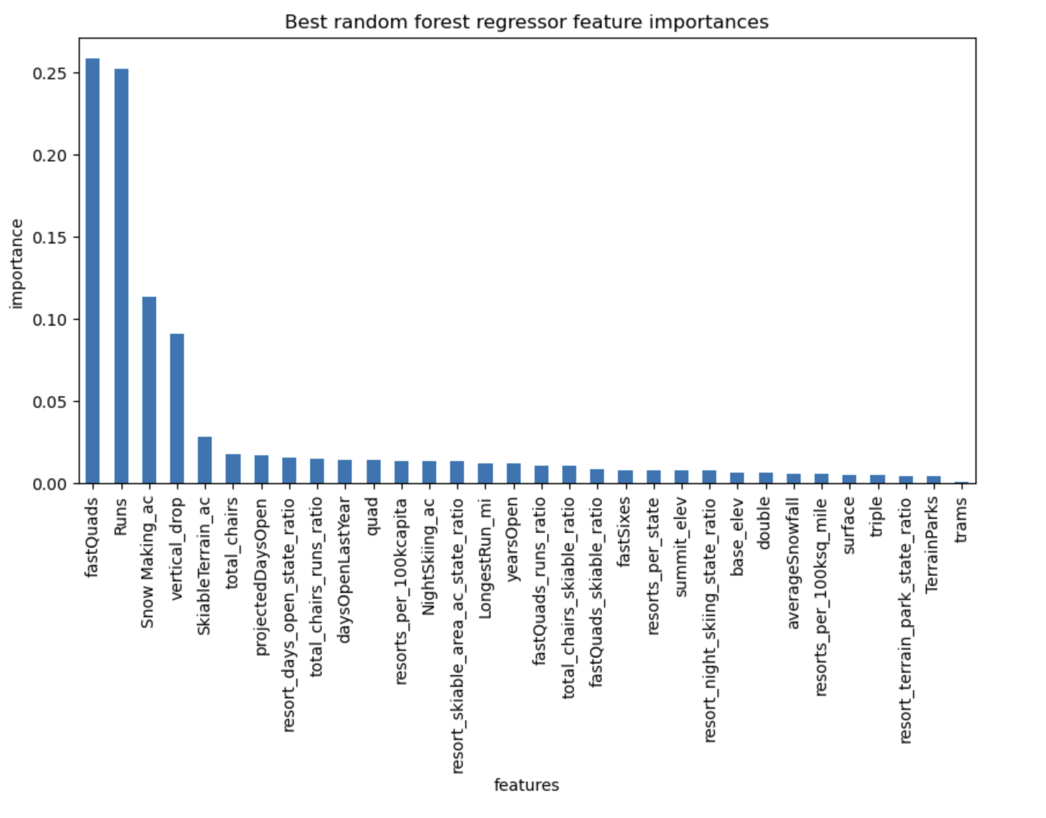
Features Most Correlated with Price
Fast quads
Runs
Snow Making
Vertical Drop

Slide 6
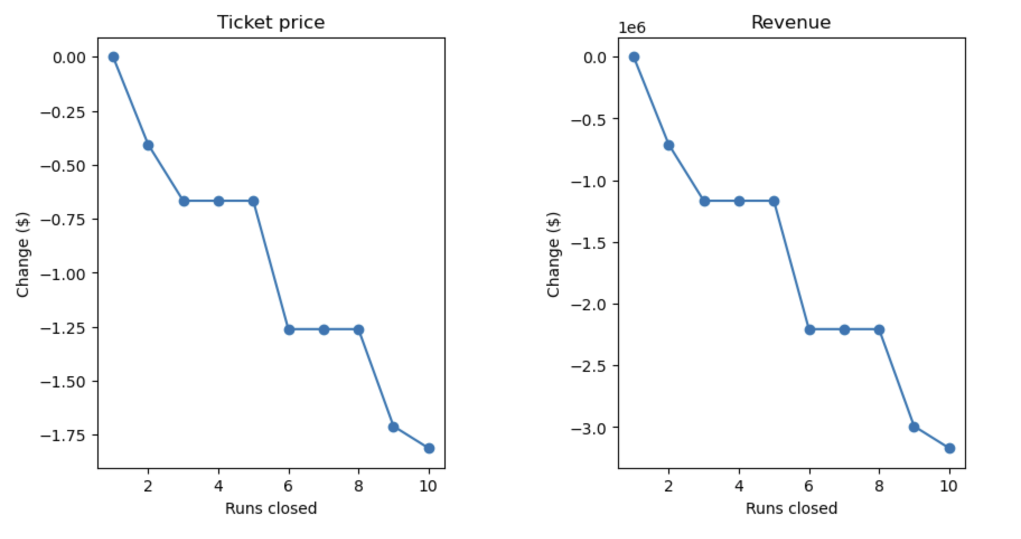
Model Supports Closing Runs
Findings support that Big Mountain can close up to 5 runs without significant impact to price or revenue

Slide 7
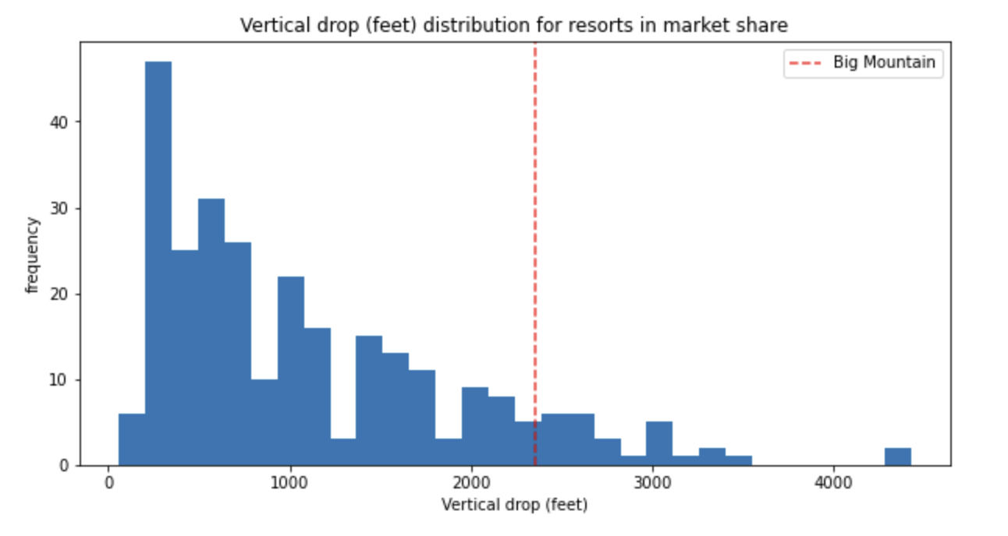
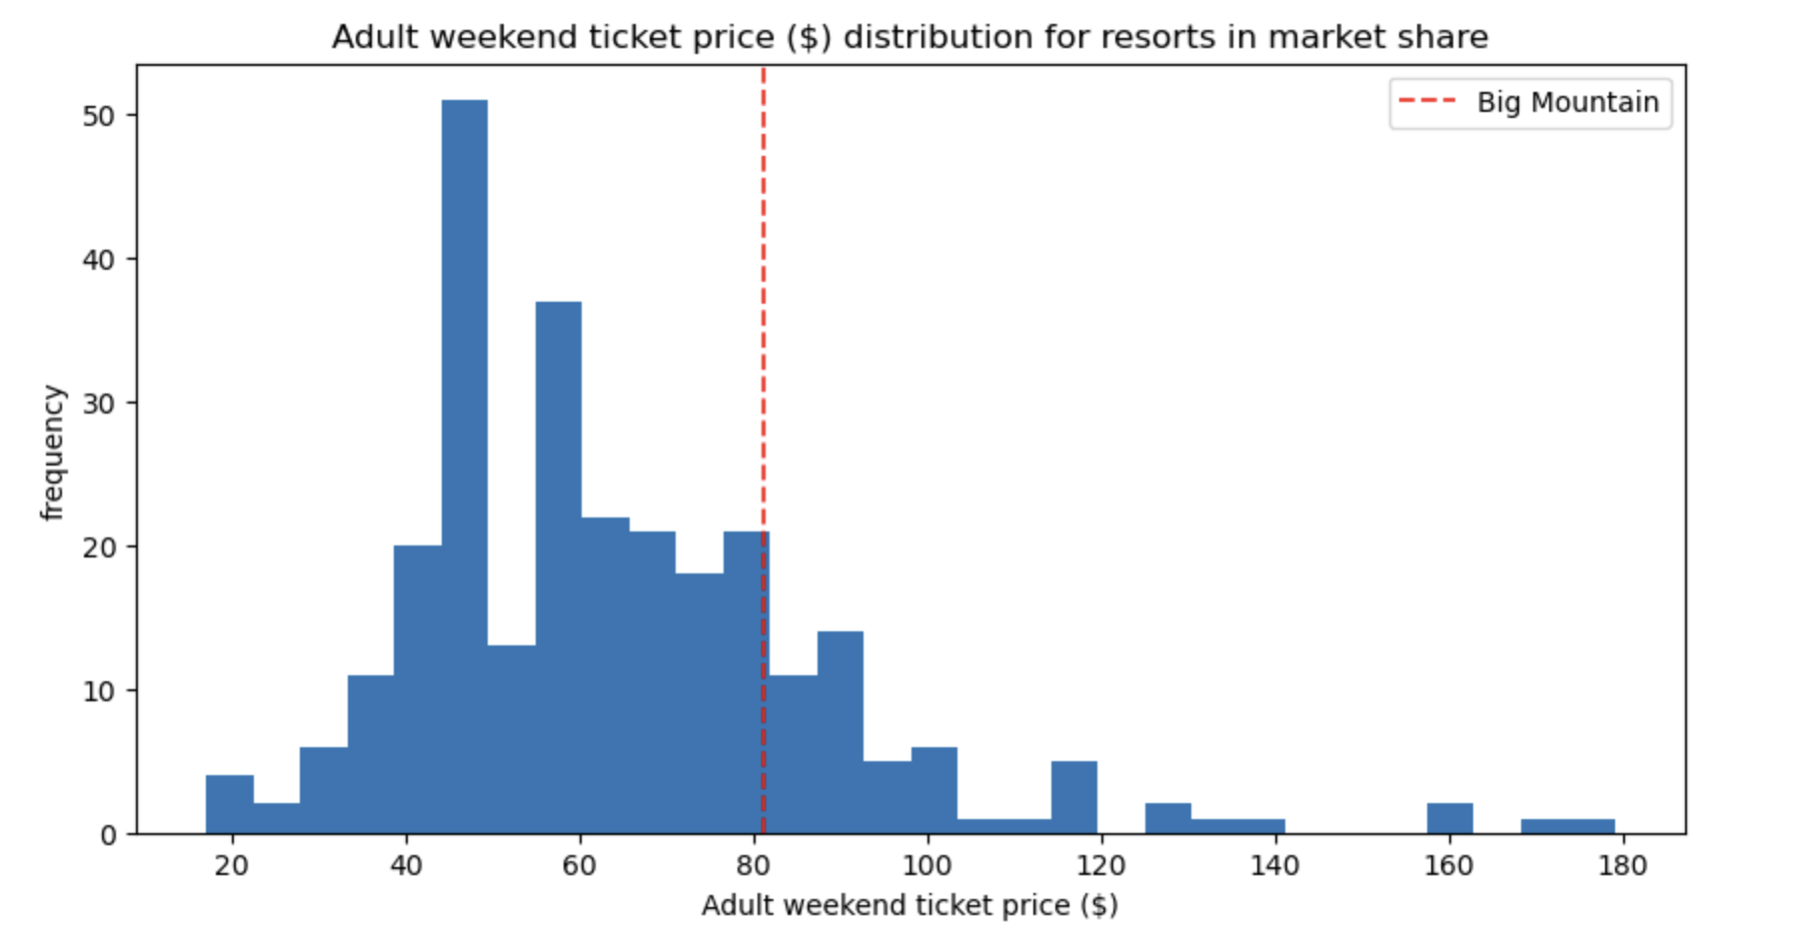
Vertical Drop Increase
Compared to competition, Big Mountain has significant room to increase vertical drop. As this is closely correlated with price, this is the current investment that most justifies an increase in ticket price.

Slide 8
A data-driven analysis supports increasing Big Mountain Resort ticket prices from $81 to $90 on the basis of removing the 5 least used runs and increasing the vertical drop by 150ft along with chair lift access.

